Slide 1


MECHAURA 2022 design dexterity challenge
Submitted by,
Sneha M S
The Armrest battle
© 2022 Collins Aerospace. | Collins Aerospace Proprietary. | This document does not include any export controlled technical data.

Slide 2
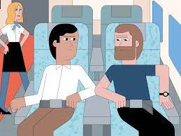
THE ARMREST BATTLE
PREMISE:
Hostile elbow exchanges with fellow fliers are frequently listed as among the biggest annoyances of being crammed into an aircraft with other humans. This causes unpleasant flying experience and discomfort to passengers, especially in the economy seating.
Highly effects middle seat passengers, as compared to the rest. Physiologically different people may need more, or less space and can hence, cause conflicts.
This poses an opportunity to innovate and solve this problem.

Slide 3
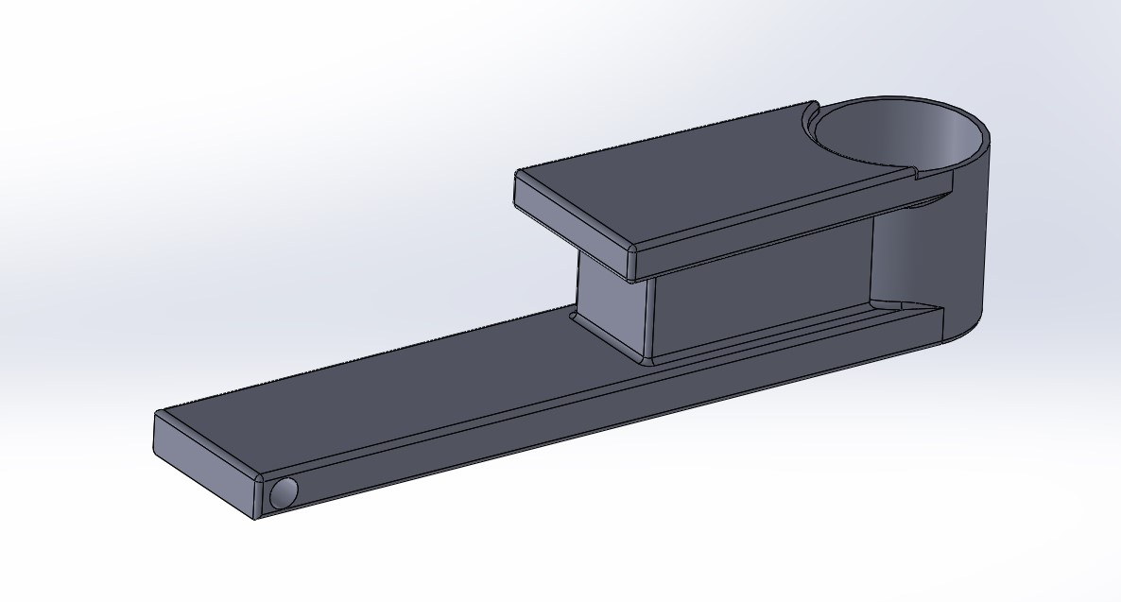
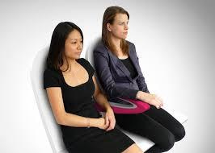
SOLUTION PROPOSED
Inspired from the paperclip design in which adjacent passengers share the armrest without uncomfortable contact, this proposed model also has two levels of arm rest along with a bottle holder.
Proposed Design
Paperclip Design - Inspiration

Slide 4
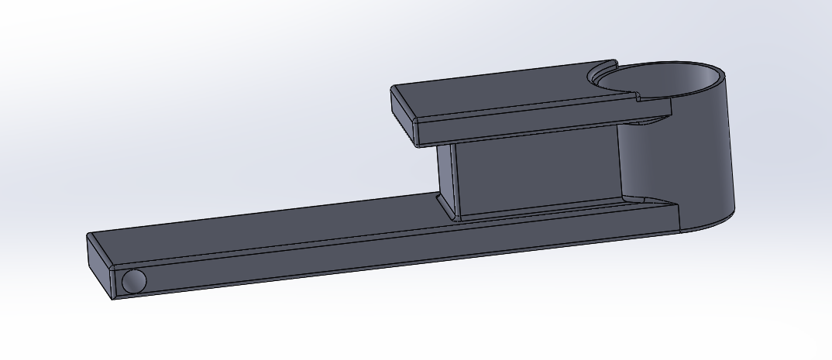
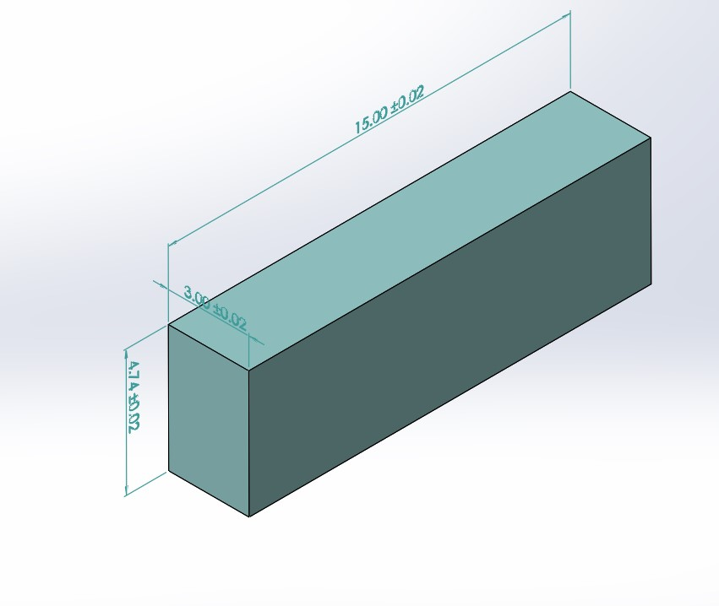
DESIGN DETAILS
Dimensions of the armrest:
Height : 3.4”
Total Length : 15”
Total Width : 3”
Diameter of Bottle Holder: 2.76”
Depth of Bottle Holder: 2.60”
Space available in the bottom level for resting arm : 5.2”
Space available in the top level for resting arm: 4.3”
Salient features:
Ample space is available in the upper and lower levels of the armrest for both the passengers.
More than half of the water bottle fits inside the holder and hence it will be held firmly.
Since it’s attached between the seats using hinge mechanism, the armrest, which can be moved up or down, is required to be down during take off or landing, and a hinge lock keeps the armrest in the down position

Slide 5
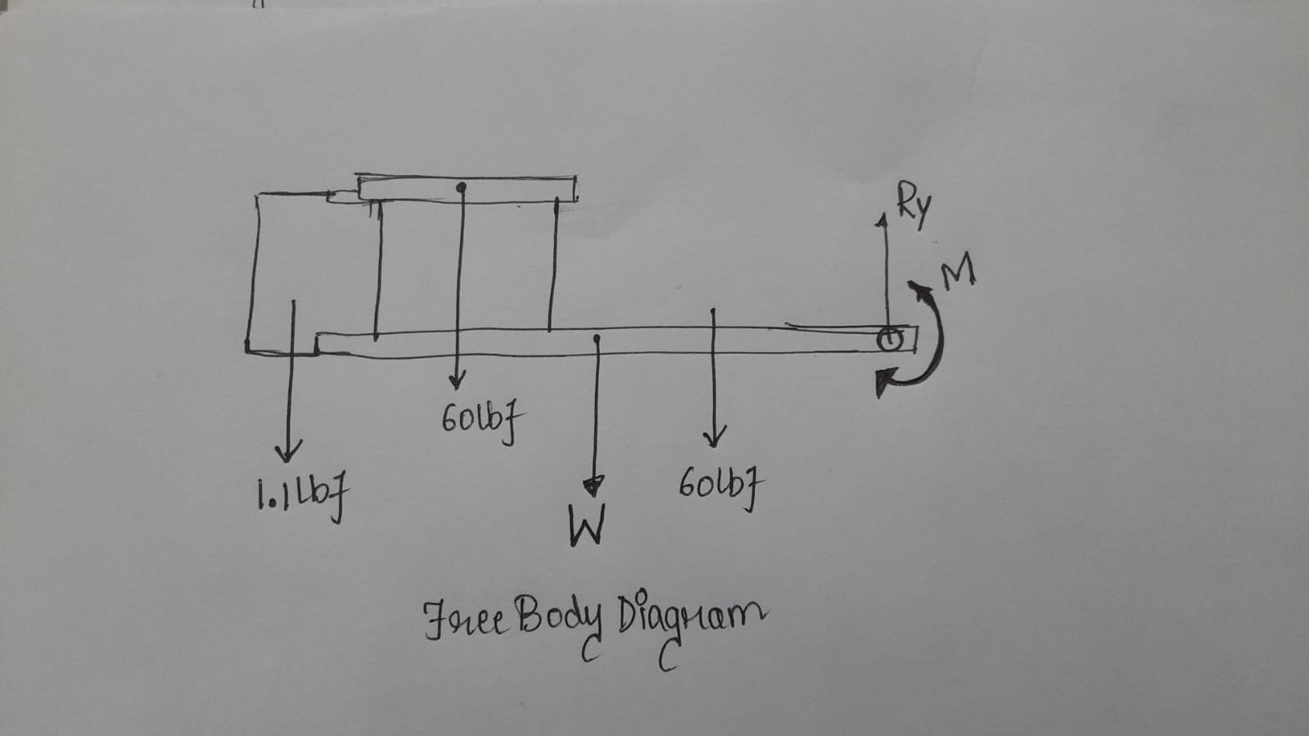
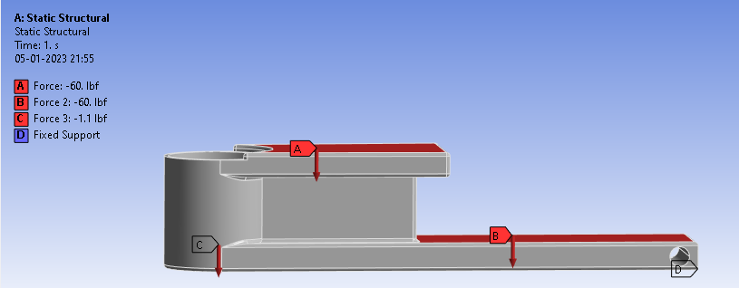
fbd / mechanism
Forces acting on the armrest:
60 lbf each on the upper and lower levels of the arm rest
1.1 lbf (Weight of 500ml water bottle)
Weight of the armrest

Slide 6
Material and manufacturing process
Material proposed: Thermoplastic Polyurethane
Material Property | Value
Density | 1.28 - 1.66 g/cm3
Young’s Modulus | 0.621 – 5.50 GPa
Poisson’s Ratio | 0.3897
Hardness (R) | 60 - 70
The material must be highly abrasion resistant, as the armrest is one of the most high-touch surfaces on the plane. Thermoplastic polyurethane is a popular material option for this reason, a type of plastic with abrasion-resistant, UV-resistant, chemical-resistant, and elastic properties.
Polyurethane (PU) can be molded in a variety of ways — open-cast, compression, spin cast and low-pressure injection. Polyurethane tooling is lower cost due to the simplicity of the tooling, the ability to gravity fed individual cavities, and the constant temperature processing, requiring no cooling lines. Machining and Cryogenic Deflashing are some of the methods used as finishing operations. Polyurethane armrests can also be made using Additive Manufacturing (3D printing)

Slide 7
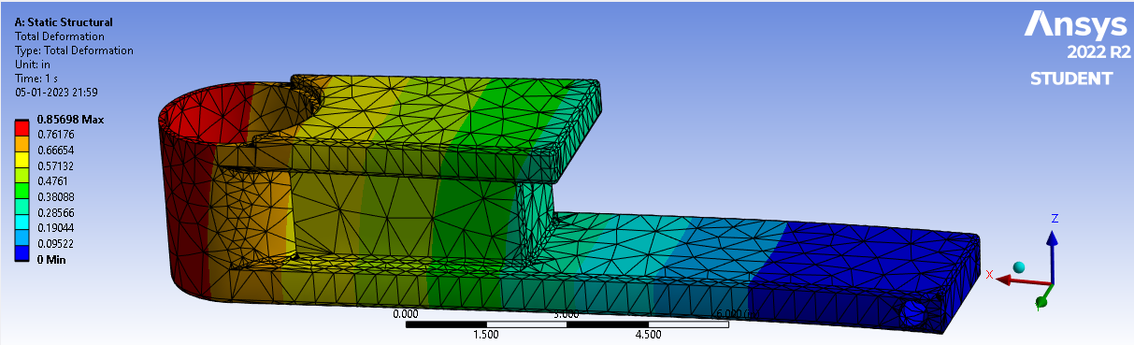
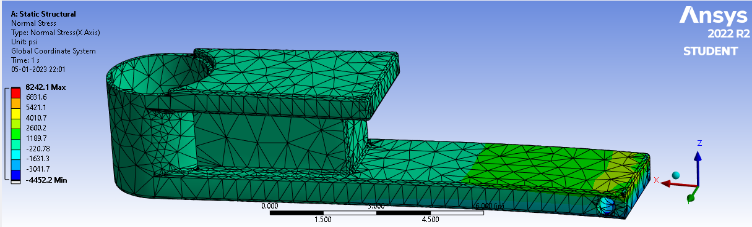
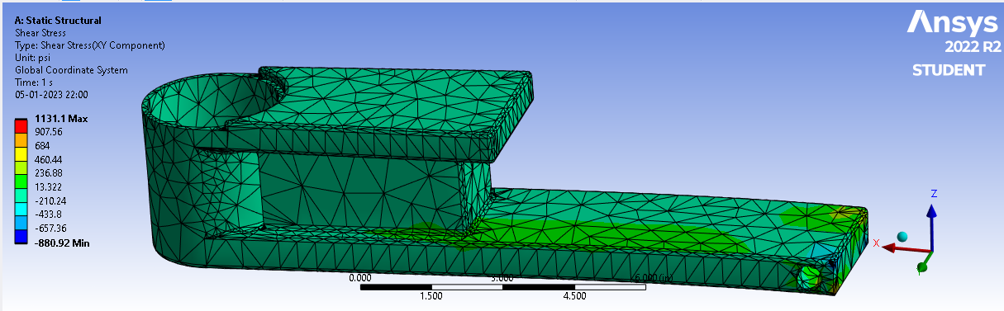
analysis
Material Property | Value Used
Density | 1.47 g/cm3
Young’s Modulus | 3.06 GPa
Poisson’s Ratio | 0.3897
Hardness (R) | 65
The maximum deformation was found to be 0.8” and both the normal and shear stresses are under the maximum strength of thermoplastic polyurethane. The designed structure can withstand more than 120lbf of load.

Slide 8
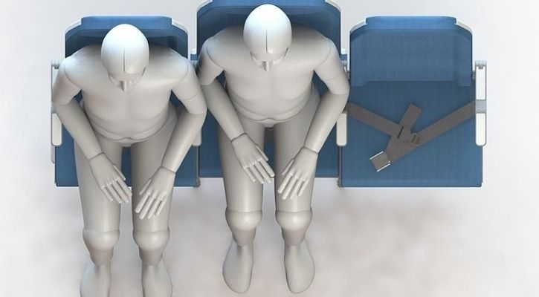
miscellaneous
Nowadays airplane seats use a staggered design in the same traditional three-seat format, where the middle seat is shifted a few inches lower and back compared to the aisle and window seats, as well as being three inches wider. This is done to make the middle passenger less claustrophobic.
The proposed design can be implemented in such designs as well, where the passenger whose seat is backward can use the lower level armrest while the other can use the higher level armrest.

Slide 9
conclusion
This was an attempt to propose a solution to the armrest problem – two level thermoplastic polyurethane armrest. The design also incorporates a bottle holder and works on the hinge mechanism. The stresses and deformations are well within the maximum limits and the design can also be incorporated in staggered arrangement of airplane seats.
Optimization of the design using AI and ML models will definitely yield better results. Both the aesthetics and the load carrying capacity can be considerably improved.
THANK YOU!!

